Slide 1
WELCOME PARENTS! Team 6-2 Team name Geckos
Mrs. Wolf
Mr. Montgomery
Mrs. Hubble
Mrs. McVean

Slide 2
Mrs. Wolf
This is my 2nd year teaching at Rotolo.
Teaching assistant in special education and Jr. High youth director.
Coach Volleyball
I teach literature and language and social studies
I have a BA in English education from the University of Iowa
I’ve been married for 1 year and have a new home and puppy!

Slide 3
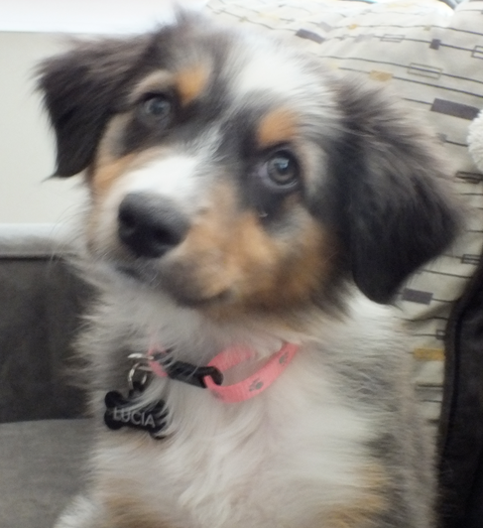
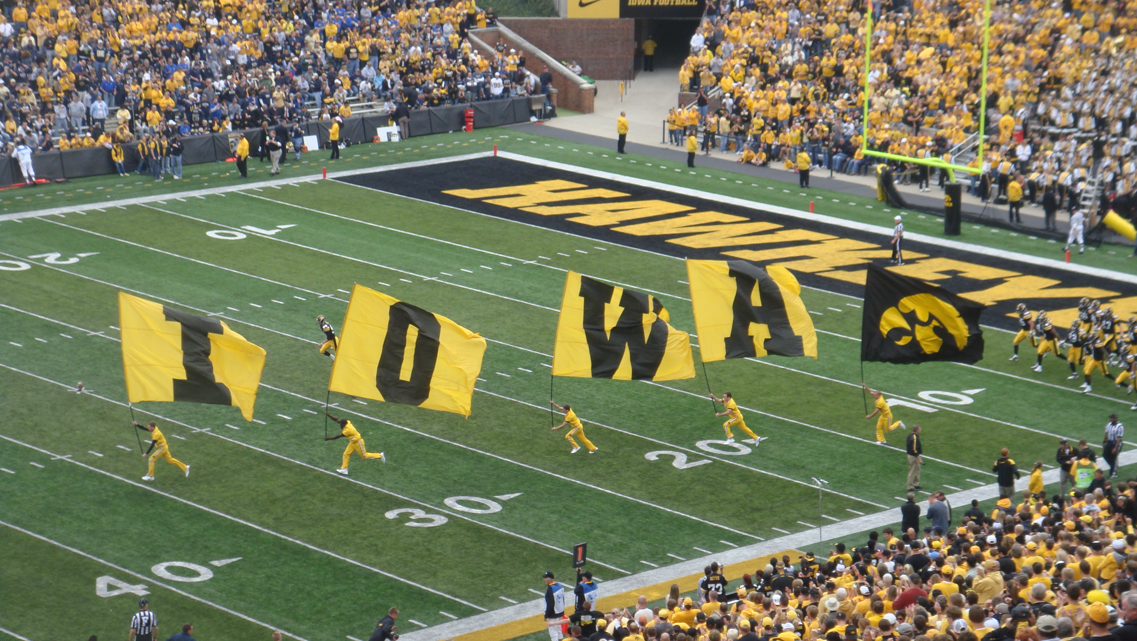

Slide 4
Language Arts
6 Trait Writing is taught throughout the year. There is a letter on your child’s desk in the room focusing on IDEAS.
Being A Writer emphasizes all parts of the Writing Process and building a community of writers in the classroom
Students will be taught conventions in the context of their published writing pieces.

Slide 5
Literature
HOLT Literature program covers all Common Core standards.
We will be using anthologies(short stories) to teach reading skills.
Novel studies will also be used to give independent practice and reinforce reading strategies and literary elements.
Monthly Reading Logs- minimum 90 minutes a week

Slide 6
Mr. Montgomery
USMC : Corporal in the Marines 1985-89.
I have been married for 14 years. We have 2 children- Cole a 8th grader and Logan a 6th grader.
I have been teaching in Batavia now for 14 years.
I teach Social Studies for 2 classes, Advisory 1 class and Math to all 3 classes on the team.
I earned both my BA and MA at Northern Illinois University.
My favorite pastime is boating and spending time on the Lake.

Slide 7
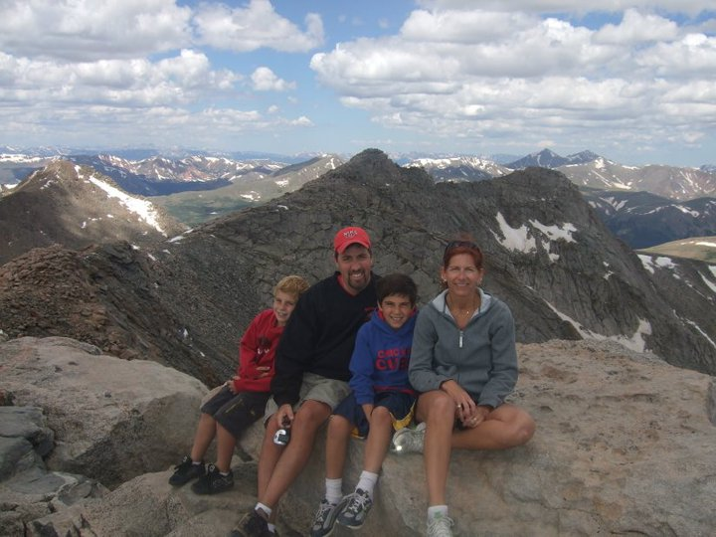
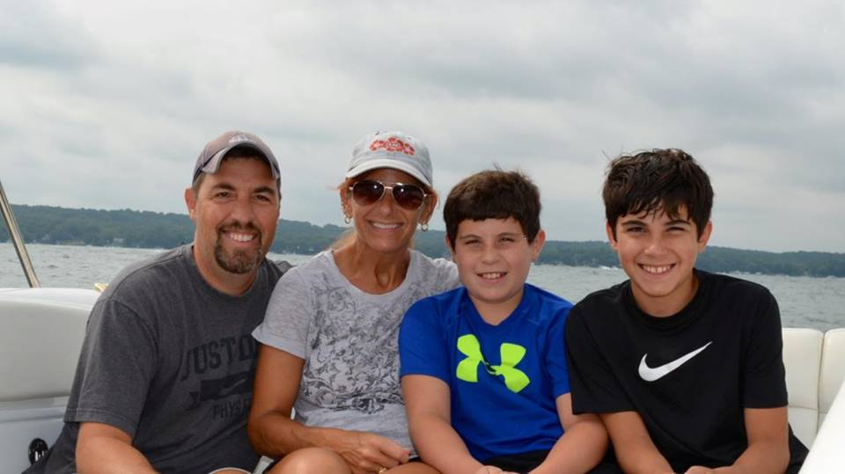
The Montgomery Family

Slide 8
Math.
I teach:
Math I
*Answer keys- in rooms
Math II
Content:
Standard Notation
Operations with Whole Numbers and Decimals
Variables, Formulas, and Graphs
Rational Number Uses and Operations
Introduction to Algebra/Geometry

Slide 9
Social Studies
History Alive!
Interactive, cooperative, multiple intelligences approach.
Ancient Civilizations
First civilizations
Egypt and far east
India
China
Greece
Rome
Middle Ages

Slide 10
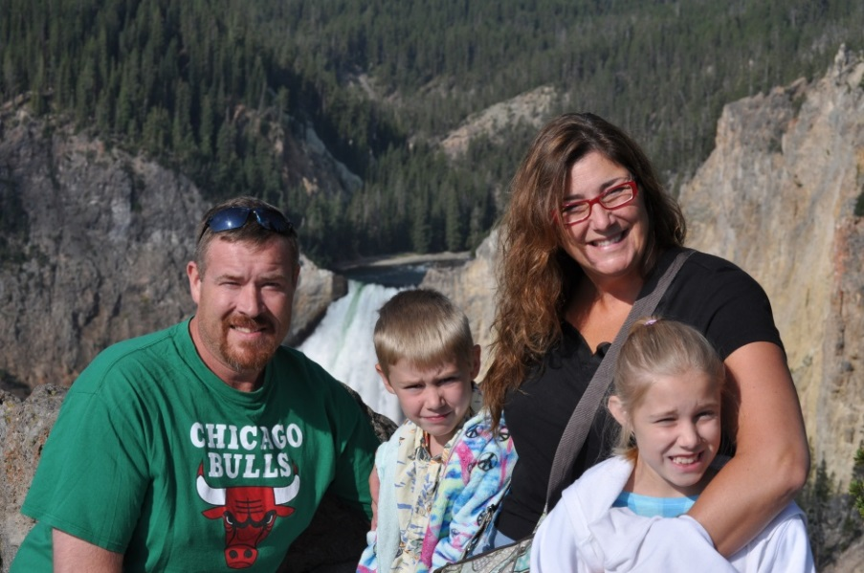
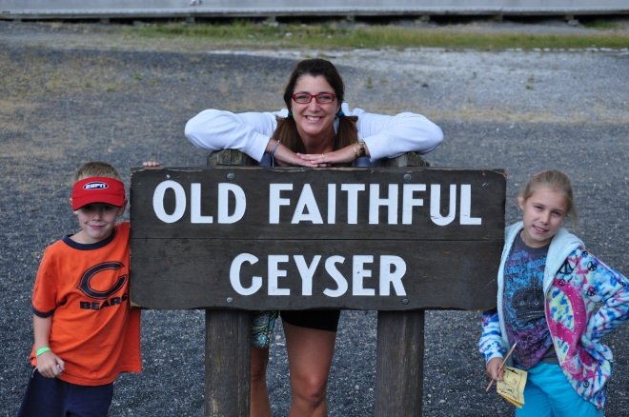
Mrs. Hubble
I've taught computers, K-5 and been a library media specialist.
Logan and Madilynn
I teach one section of Lit. /Lang and Science to all 3 classes on the team.
I have my MA in technology, loved my summer off with my children but ready to get back to the “art” of teaching!

Slide 11
Science…follow Common Core
Earth’s Water and Atmosphere
Properties of water, oceanography and Earth’s atmosphere
The Dynamic Earth
Earth’s surface, history, minerals and rocks
Space Science
The universe, solar system, Earth-moon-sun, exploring space

Slide 12
Advisory
Activities emphasizing pillars of character & team building
LMC/Silent reading time
Study Hall one day a week
Classroom Meetings
CNN News

Slide 13
Mrs. McVean
5th year teaching at Rotolo 6th grade
I teach all the subjects
BA in special education from Northern Illinois University
Working on my MA in educational leadership
I’ve been married for 2 years
I have two cats Buttons & Duncan

Slide 14
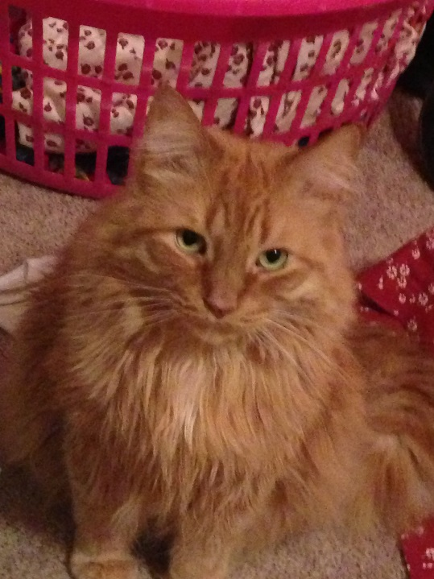
The McVean Family

Slide 15
Behavior/Discipline Plan
Boot Camp
“The Book” and Homework learning opportunity slips
Our school follows BARK- a Positive Behavior Intervention System

Slide 16
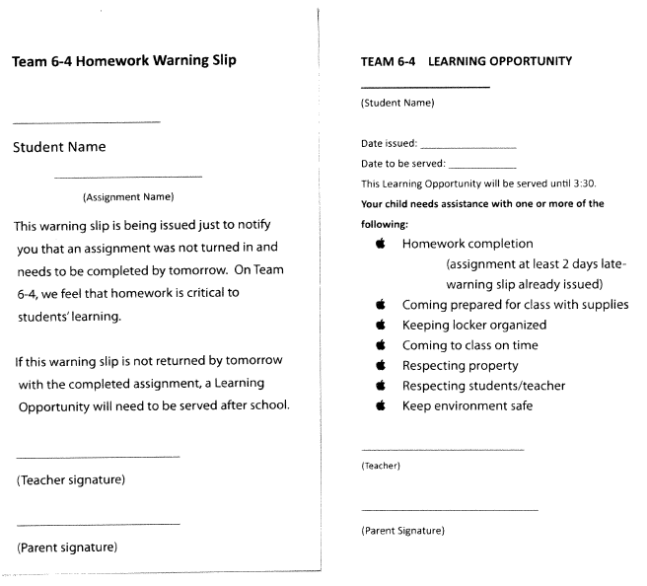

Slide 17
Parent Communication
Agendas: please look at them nightly
Notes coming home on paper are same as web page information
Phone
E-mail
Homework website
Parent/student Power school portal

Slide 18
Grading scale & Power School
A = 90-100%
B = 80-89%
C = 70-79%
D = 60-69%
F = 59% and lower
Access grades through PowerSchool

Slide 22
Thanks for coming! Please join us in our classrooms.
Room 226- Mr. Montgomery
Room 231-Mrs. Hubble
Room 228-Mrs.
Room 239-Mrs.
You will sign up for conferences in your child’s advisory room.
Contact us via email if you have specific questions regarding your child’s adjustment to RMS.

